Slide 1


FUNBOX
Offering suggestions for spare time
Cao Hengyu Yu Jinru Zhang Junyi Zhou Zhixiang

Slide 2

CONTENTS
01
User system
02
Recommendation system
03
Note System
04
Admin System

Slide 3

01
User system

Slide 4

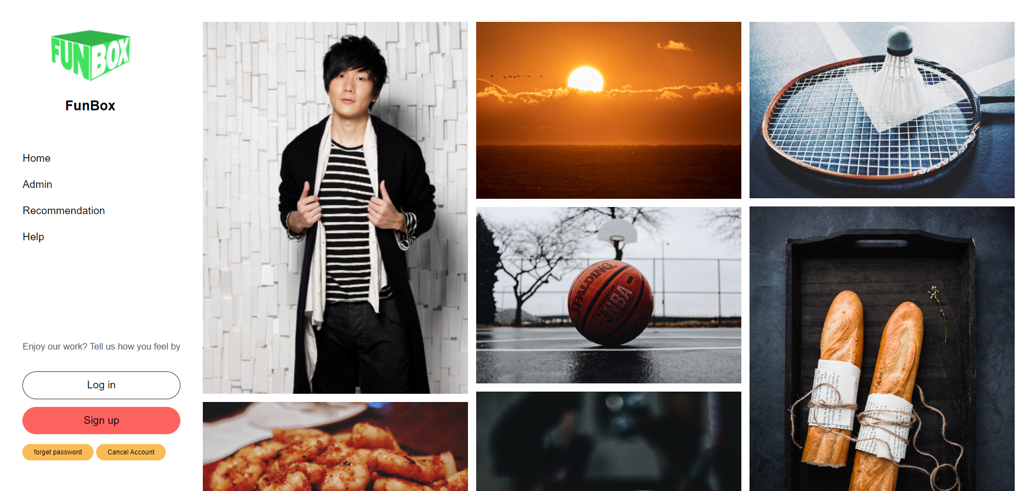
Register

Slide 5
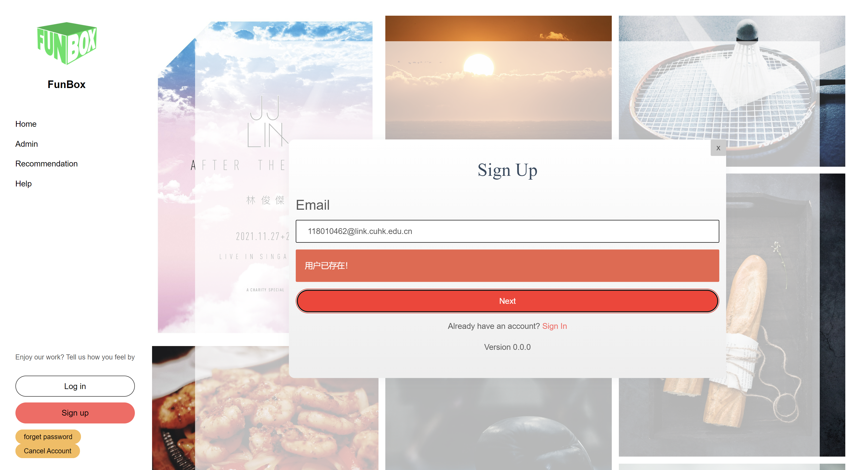
Register (Failed)

Slide 6
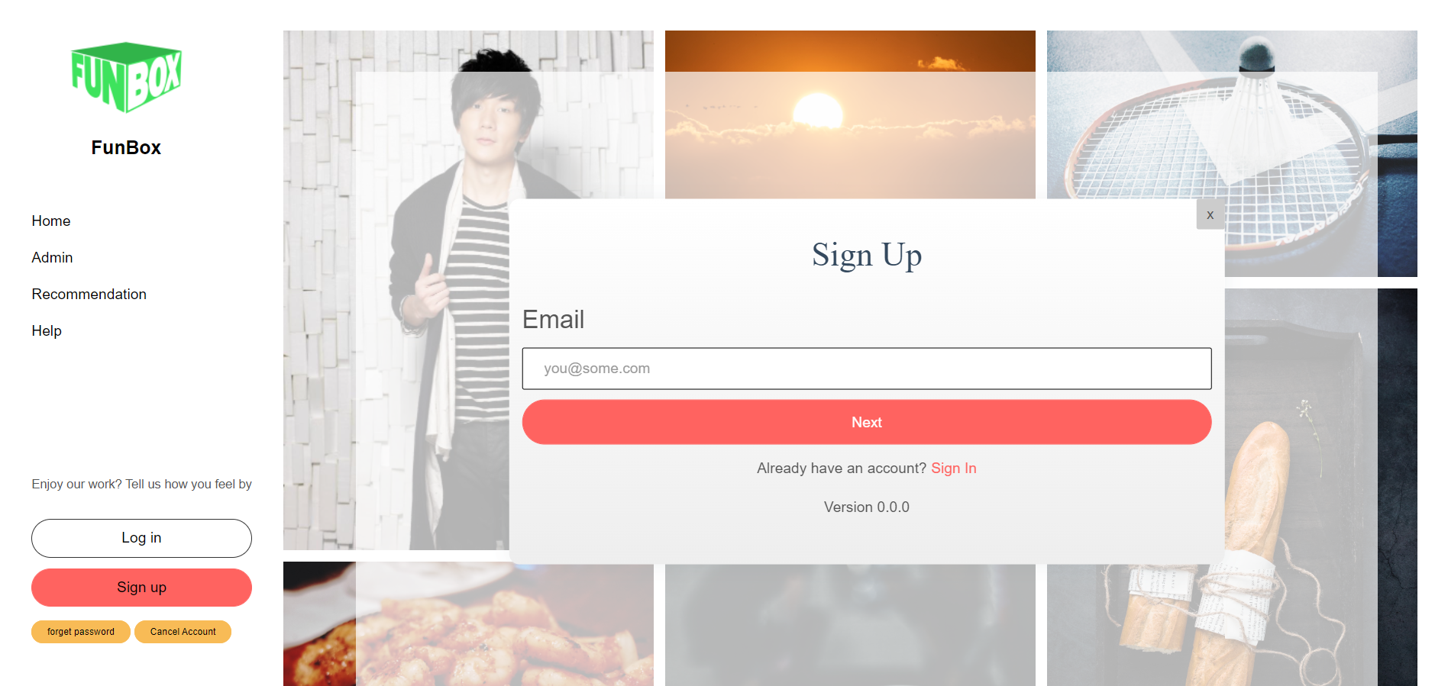
Register (Successful)

Slide 7
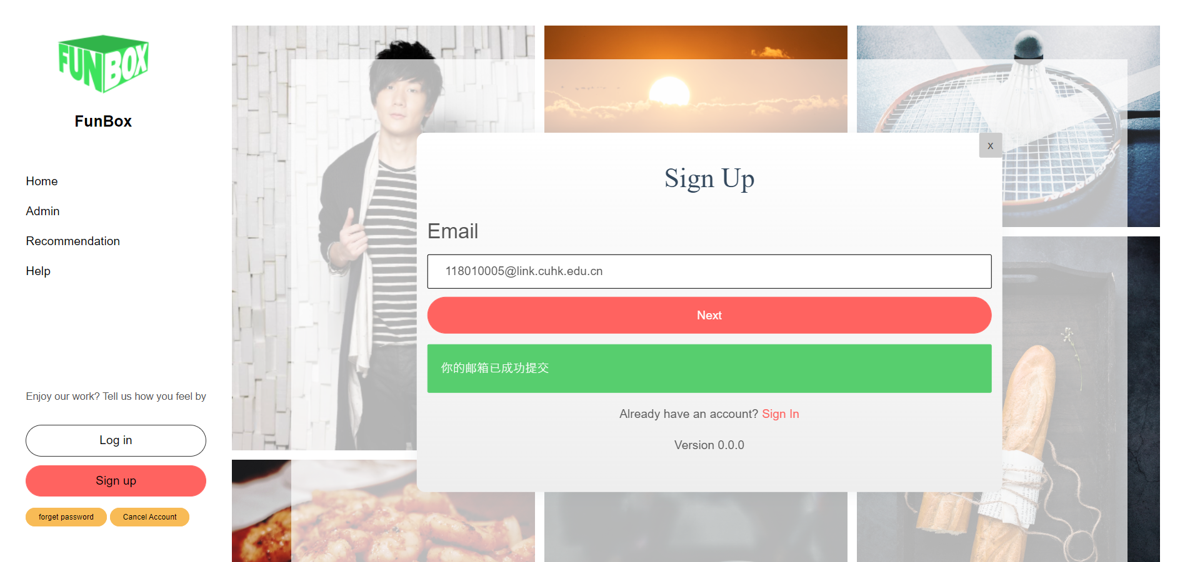
Register

Slide 8
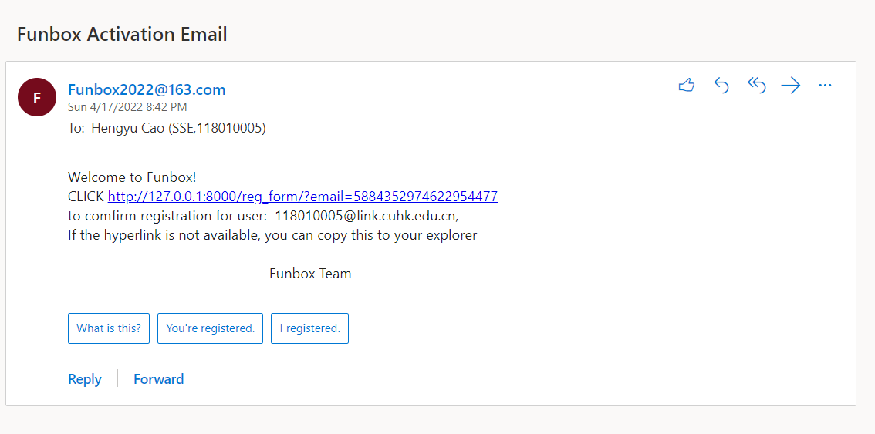
Register

Slide 9
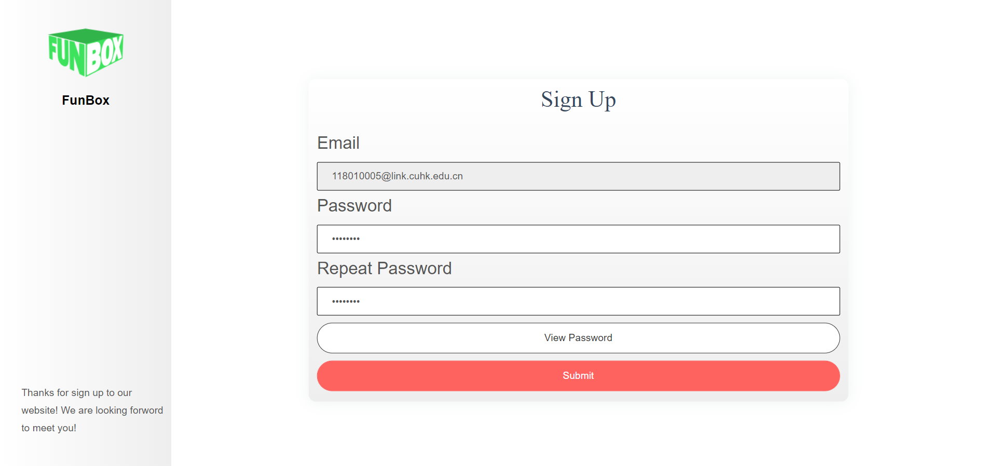
Register

Slide 10
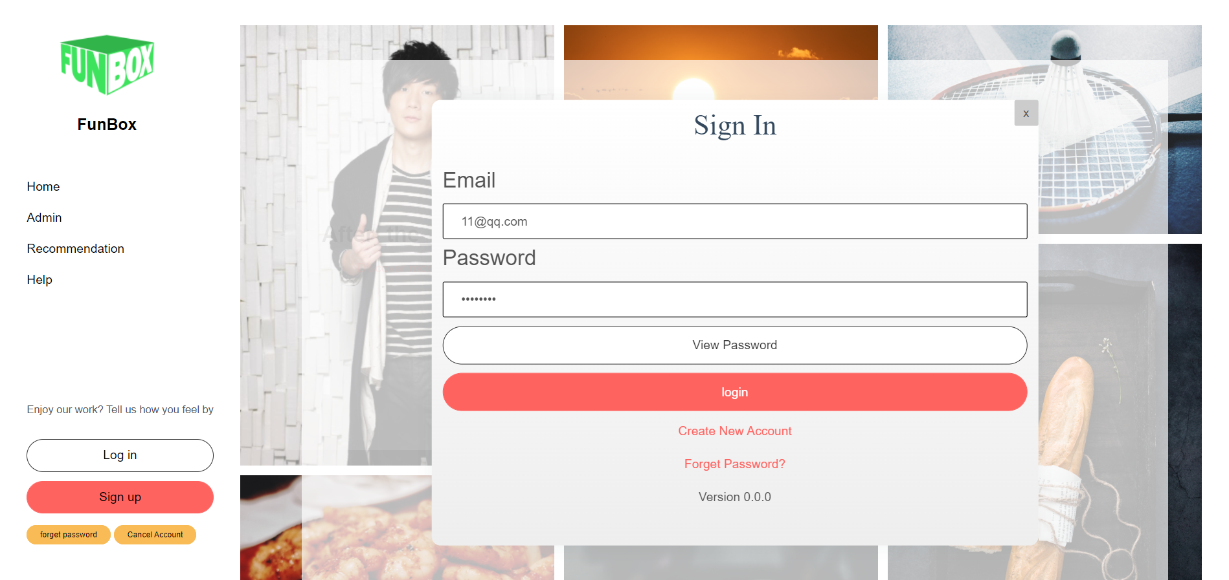
Login

Slide 11
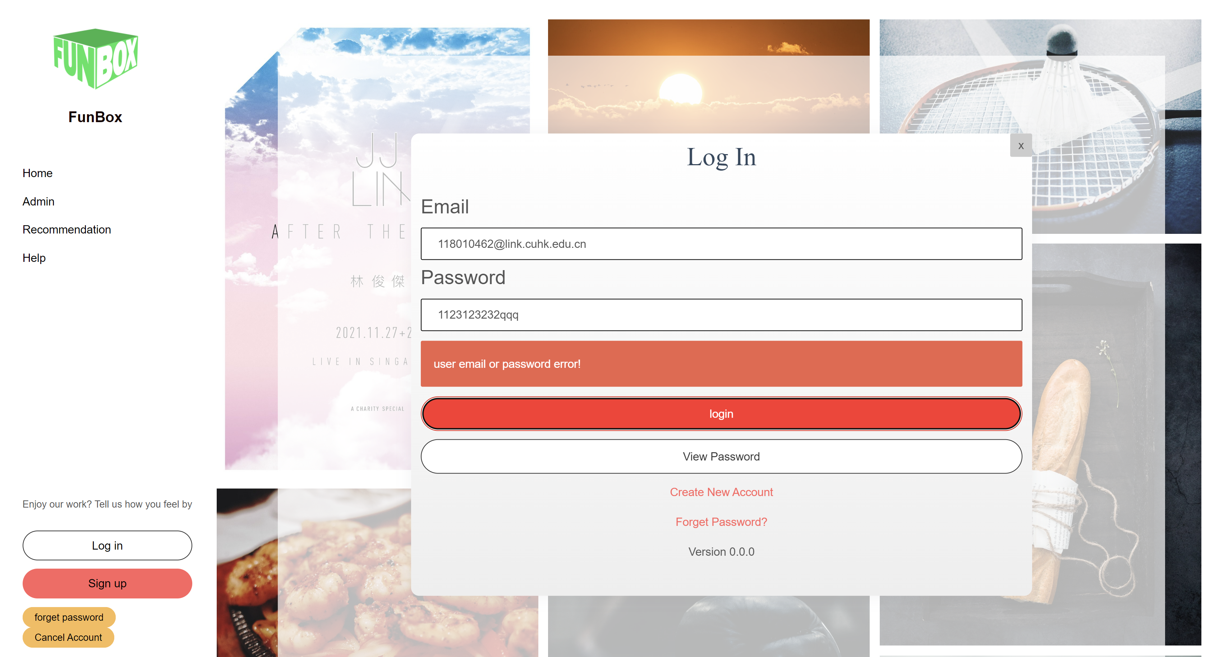
Login (Fails)

Slide 12
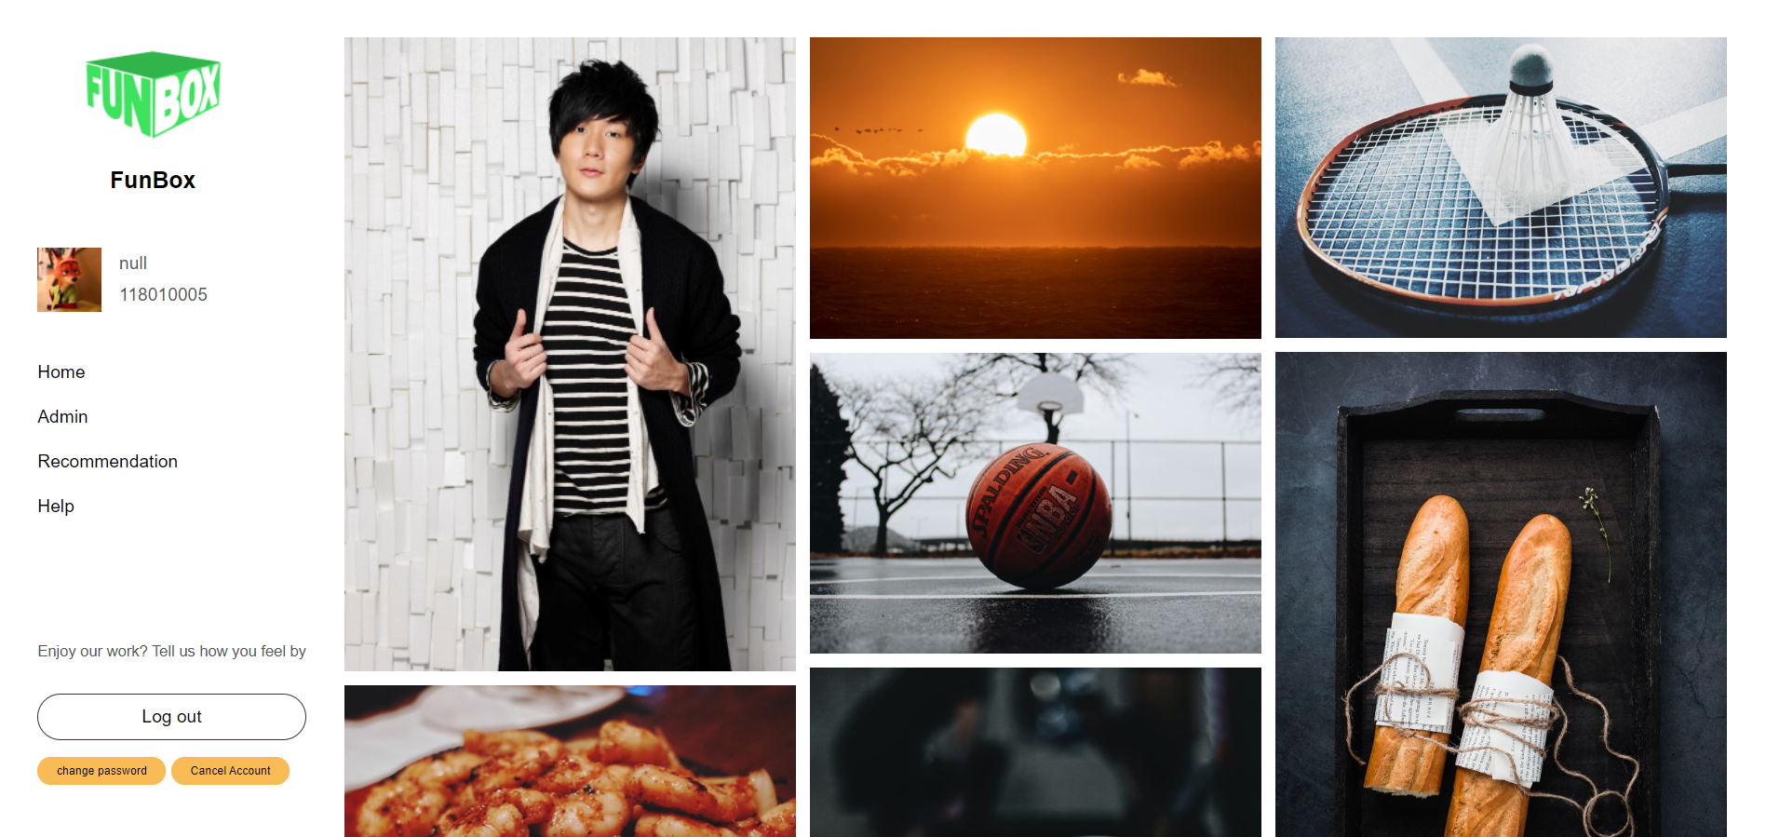
Login

Slide 13
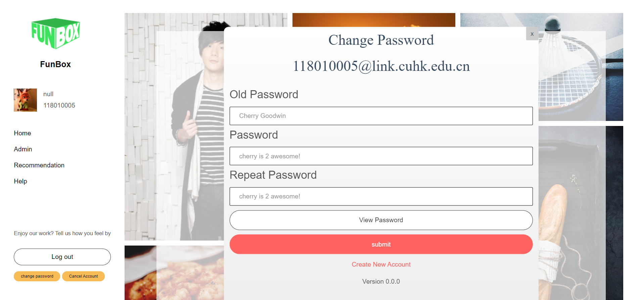
Change Password

Slide 14
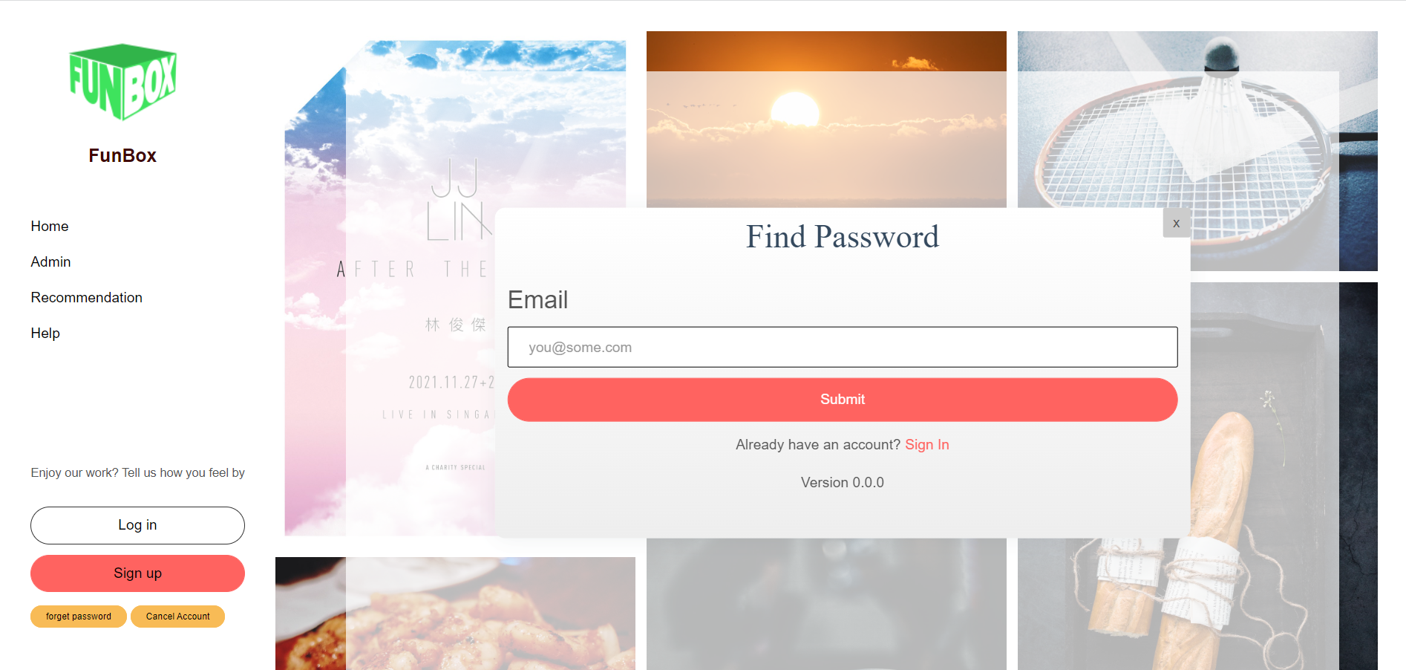
Forget Password

Slide 15
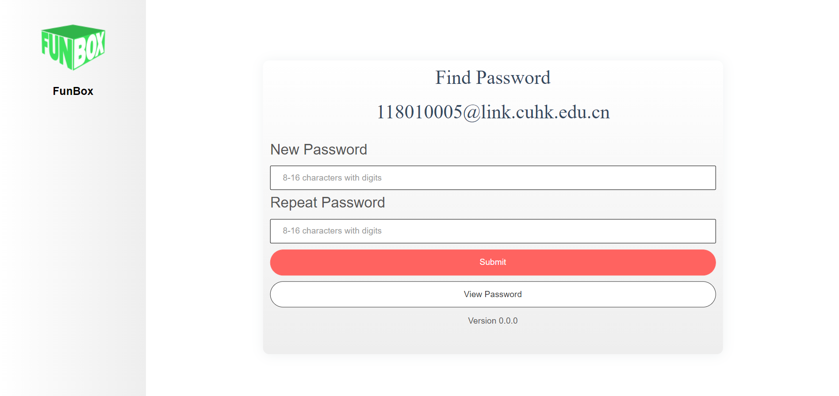
Forget Password

Slide 16
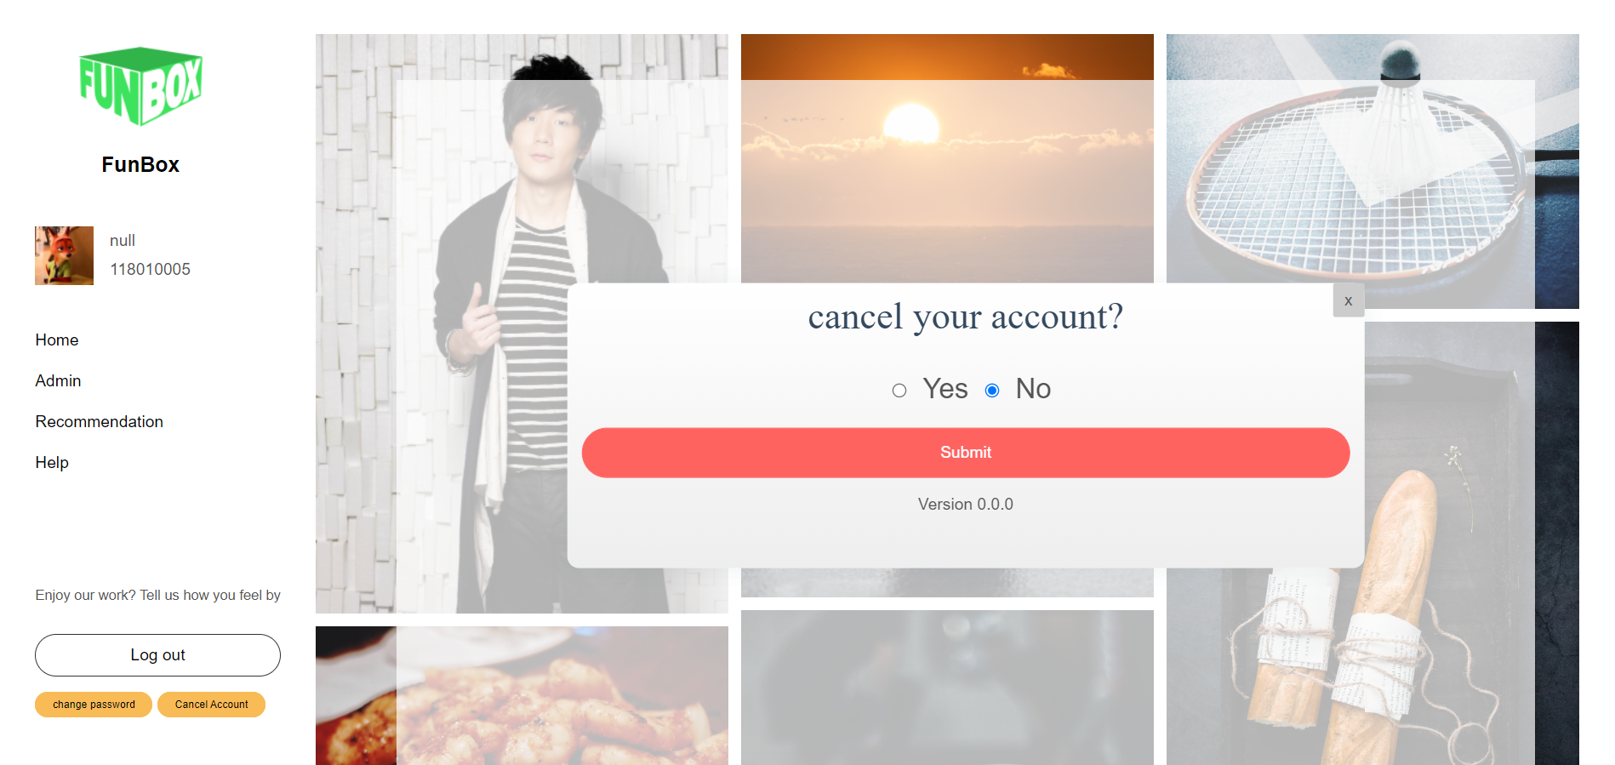
Cancel Account

Slide 17
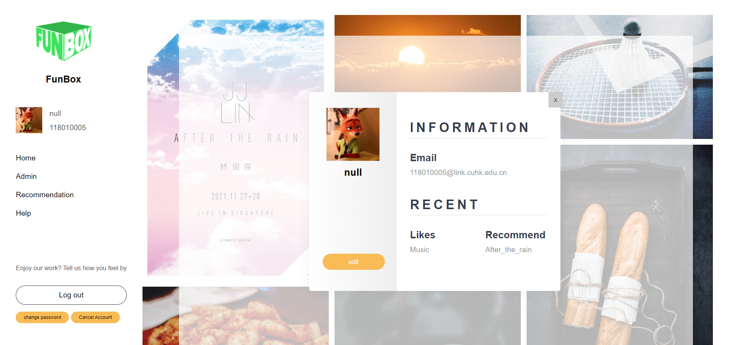
User Information

Slide 18
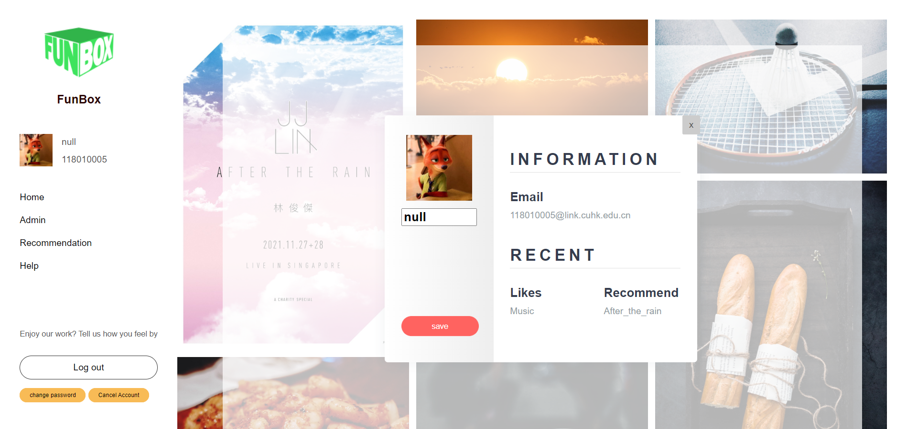
Edit User Information

Slide 19
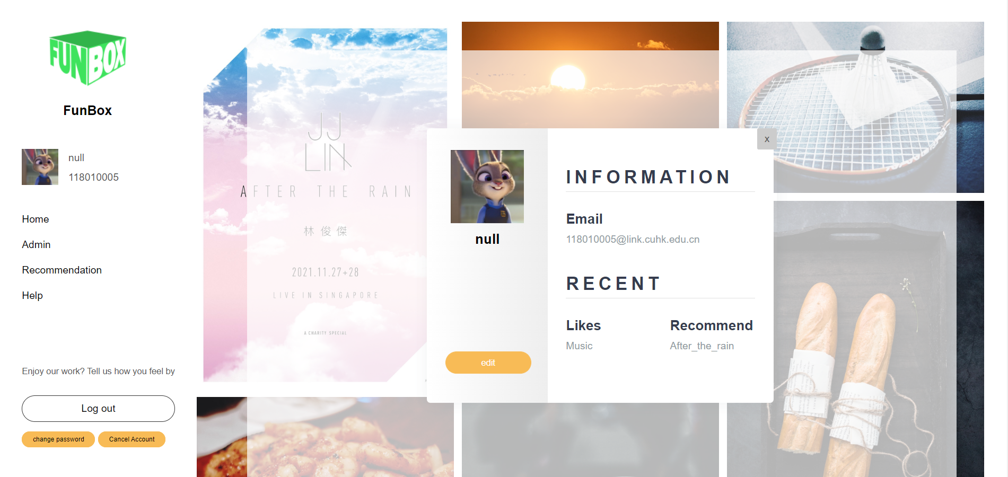
Edited User Information

Slide 20

02
Recommendation System

Slide 21
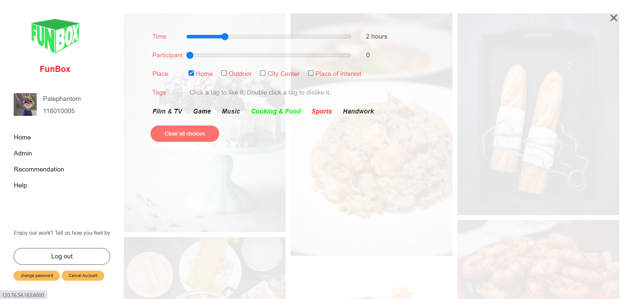
Filter System

Slide 22
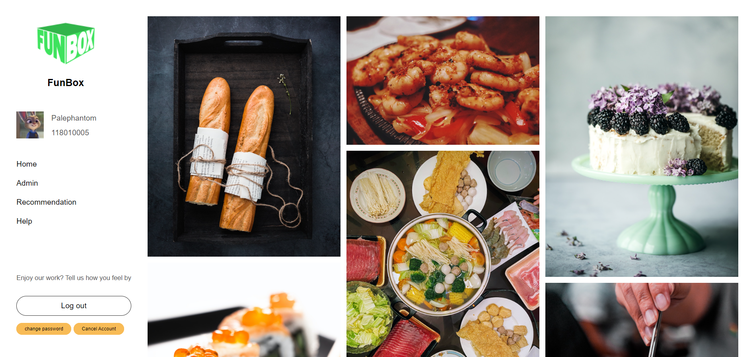
Filter System

Slide 23
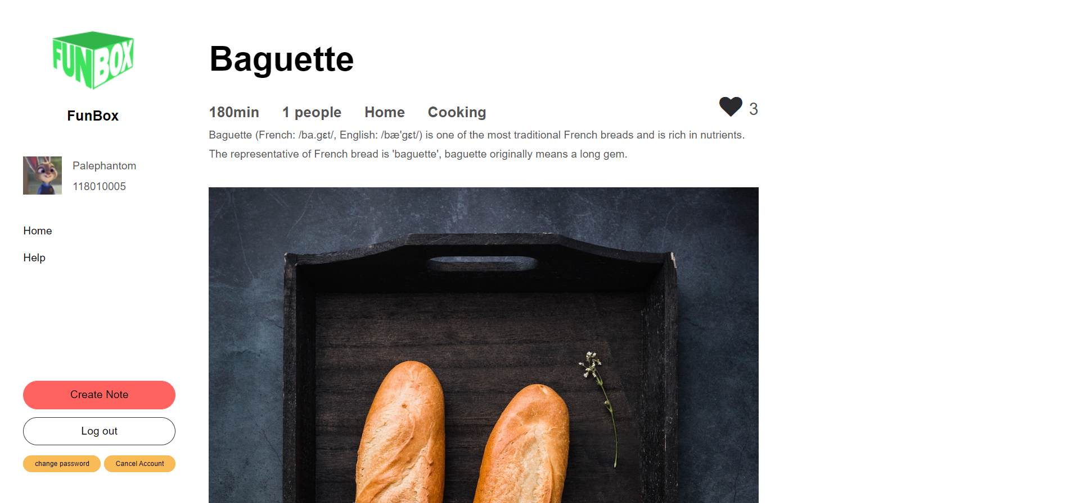
Activity Detail

Slide 24
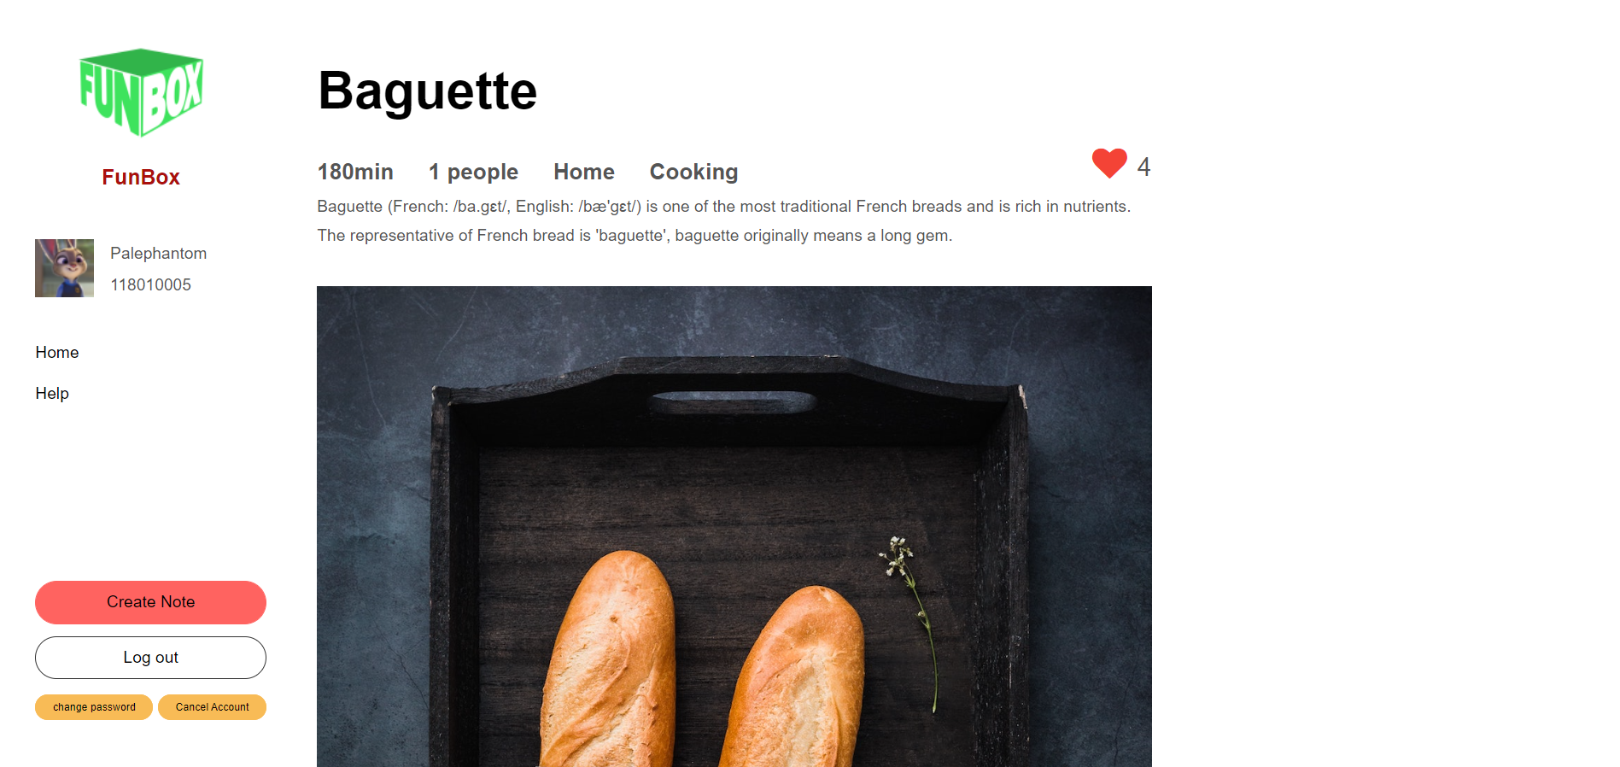
Activity Detail

Slide 25
Activity Recommendation System
Aim to offer the fittest activities
Item-Based Collaborative Filtering
Predict the unknown preference
Ranking the potential activities

Slide 26
Activity Recommendation System
User
Signals
Candidate Generation
Scoring and Ranking
Time-based
Cosine Distance
Participant-based
Pre-ranking
Filters
SVD-based Estimate
Place-based
All FUNBOX ACCOUNT
Tag-based
Post Ranking
Filters
Interest-based
Result

Slide 27
Activity Recommendation System Result

Slide 28
03
Note System

Slide 29
Activity Detail

Slide 30
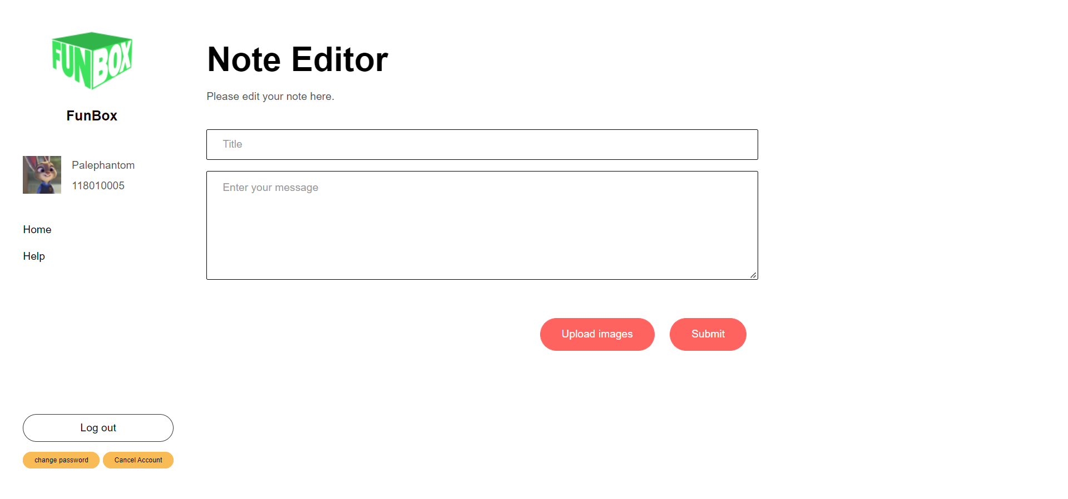
Note

Slide 31
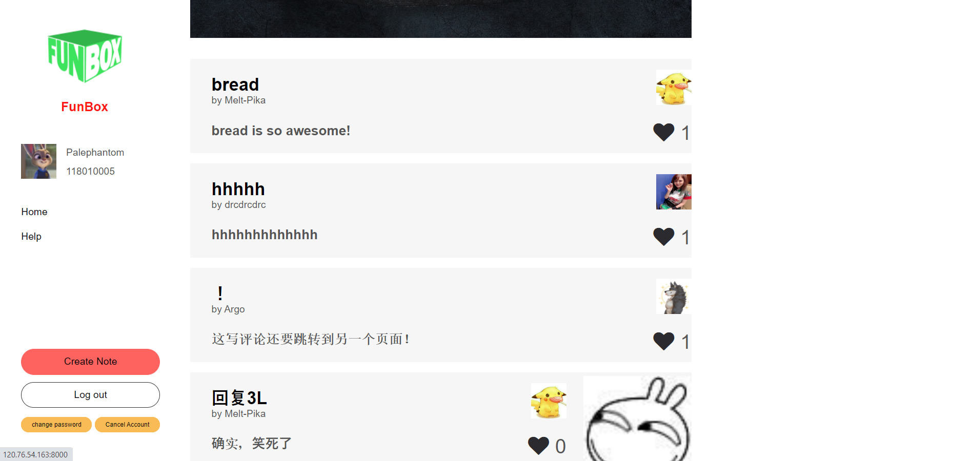
Note

Slide 32
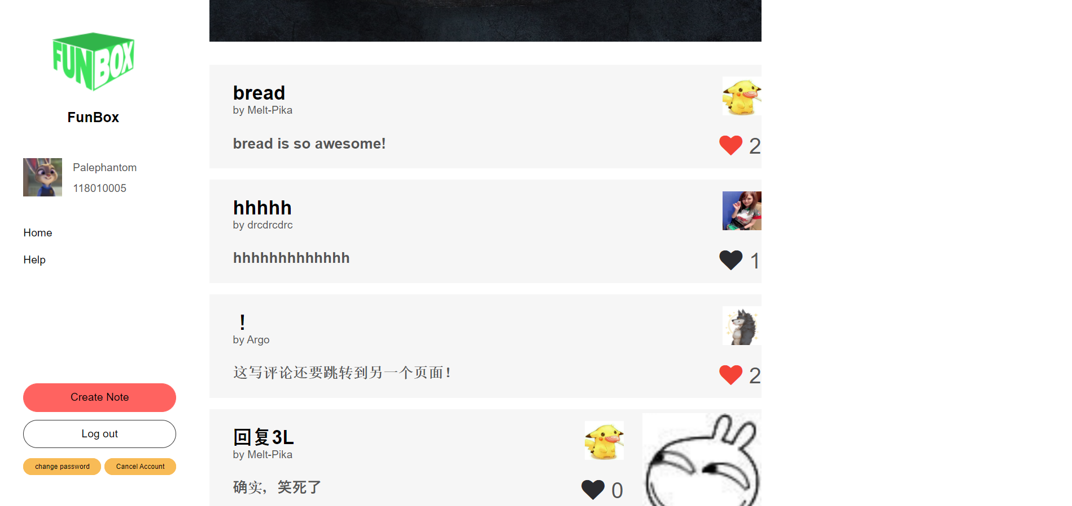
Note (add likes)

Slide 33
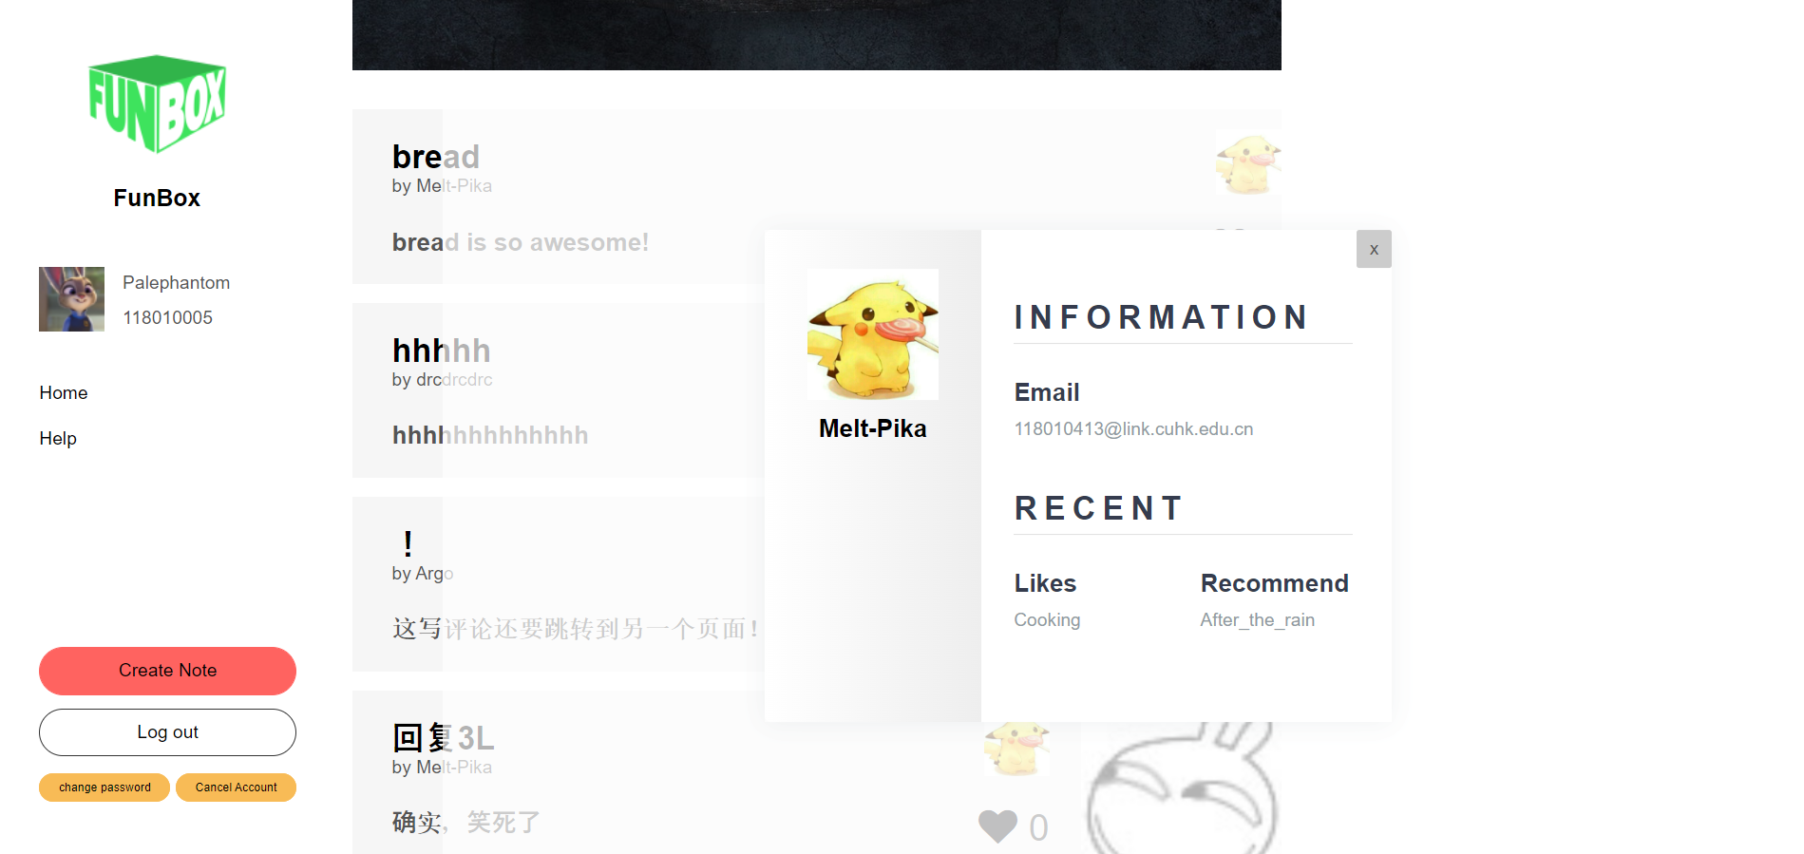
Note (Show creator information)

Slide 34
04
Admin System

Slide 35
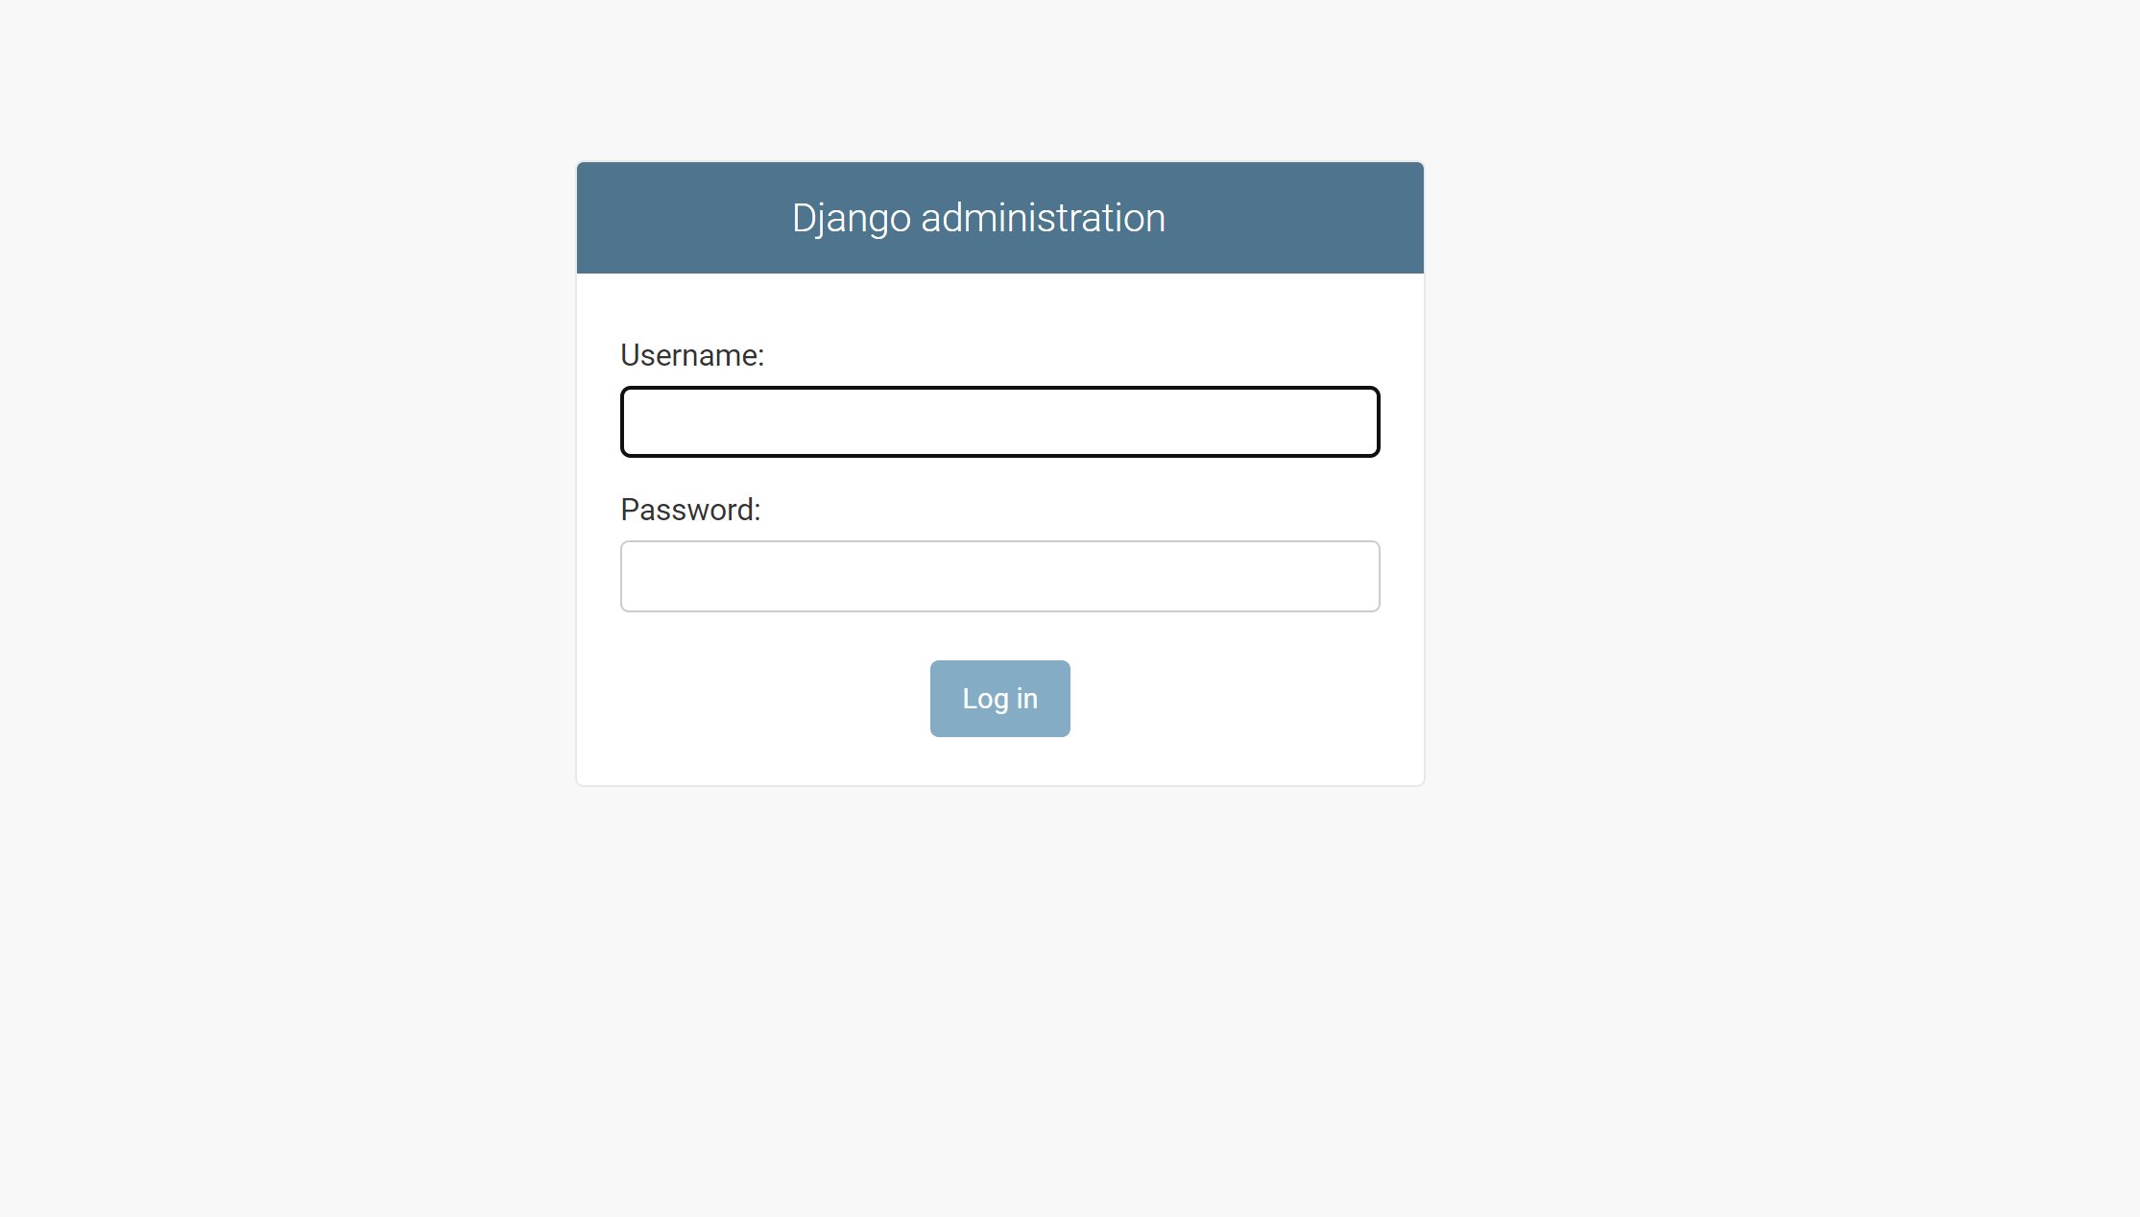
Admin (Log in)

Slide 36
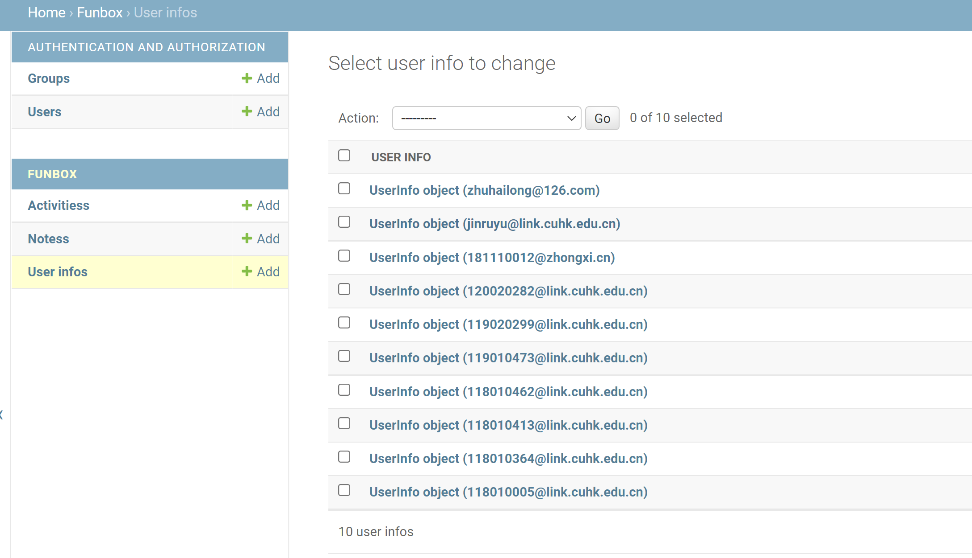
Show all users

Slide 37
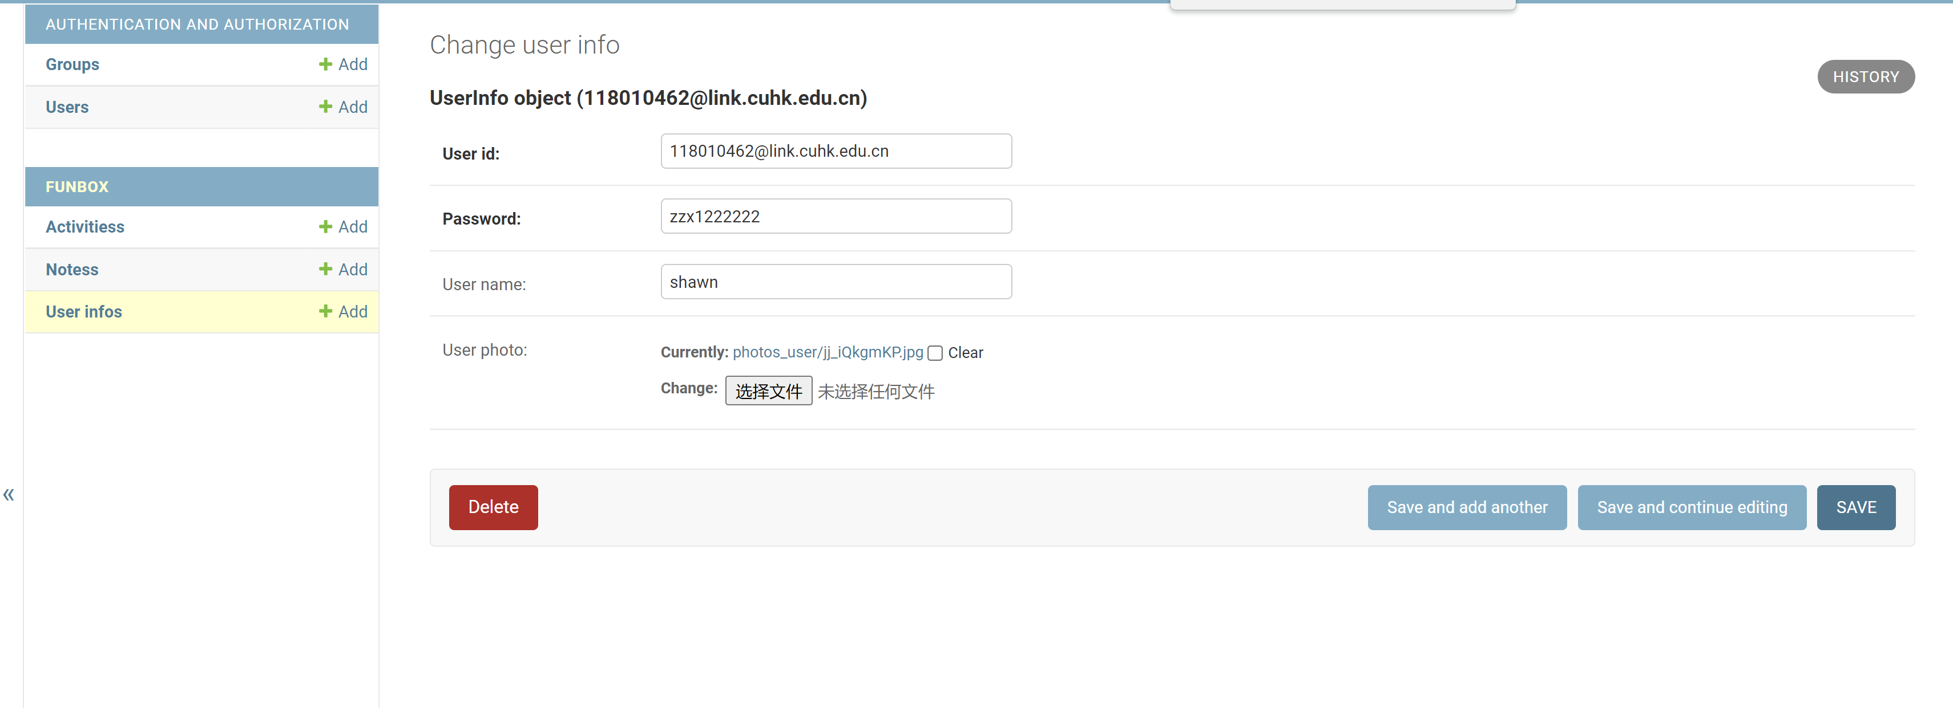
Edit User Information

Slide 38
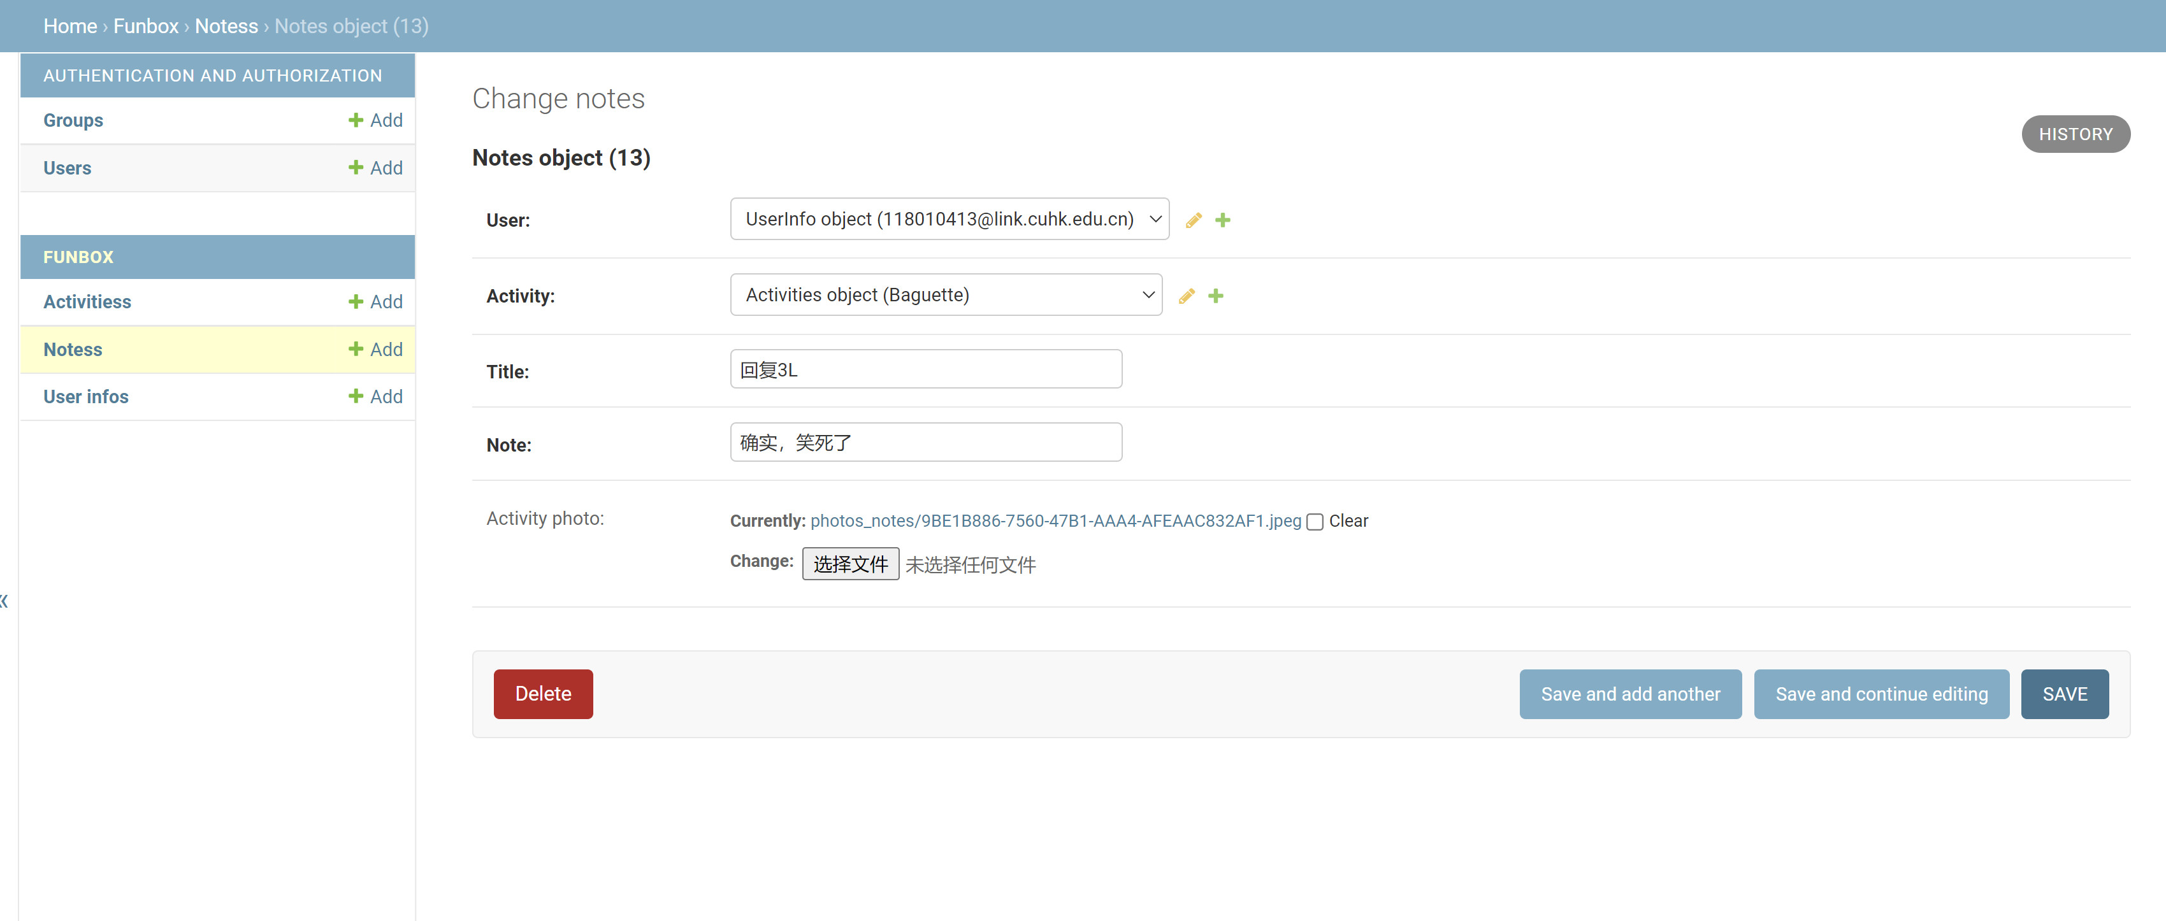
Edit Notes

Slide 39
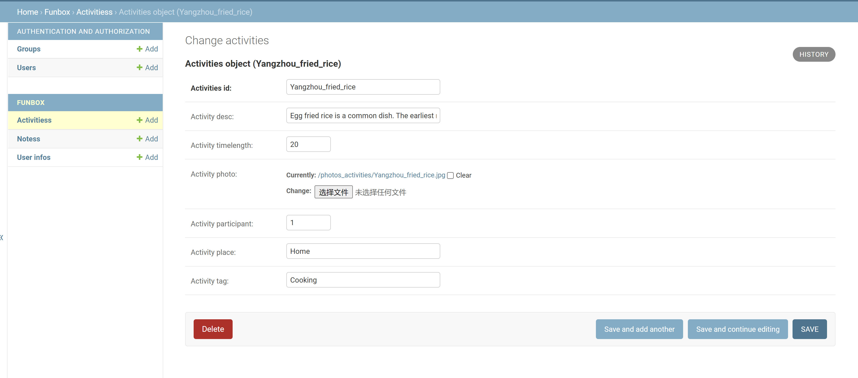
Edit Activity

Slide 40
THANKS

